Slide 1

Lab 01 programming an stm32 arm coretex-m 32-bit microcontroller
Prof. Davide Brunelli
Dept. of Industrial Engineering – DII
University of Trento, Italy
davide.brunelli@unitn.it

Slide 2
Plan a: Accessing the virtual machine

Slide 3
Plan b: running the software natively

Slide 4
Stm32 development environment
Download the archive from
https://drive.google.com/drive/u/2/folders/1tHQ5O4eaGEEBfe2oR7O2w1nYTZAlRr4r
Unzip it

Slide 5
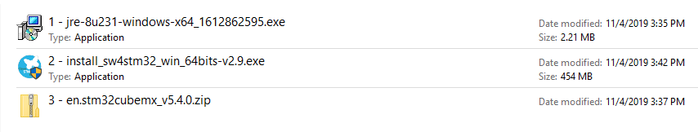
Stm32 development environment
Java Runtime Env.
System Workbench
STM32 Cube-MX
Install the 3 software following the order
Java Runtime Environment
System Workbench
STM32 Cube-MX
Finally, download MobaXterm from https://mobaxterm.mobatek.net/download.html

Slide 6
STM32 NUCLEO L4

Slide 7
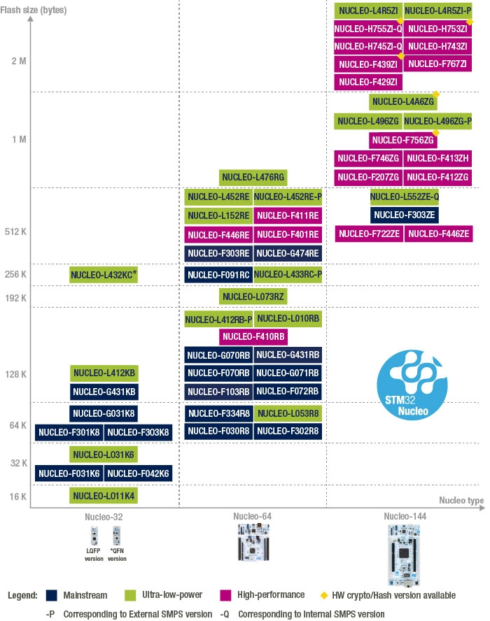
STM32 NUCLEO FAMILY
Ideal for quick prototyping
Standardized connectivity, reusable across all Nucleo boards
Extends connectivity even to Arduino boards
Each board contains an ST-LINK in-circuit debugger and programmer (usable even for external applications compatible with STM32 MCUs)

Slide 8
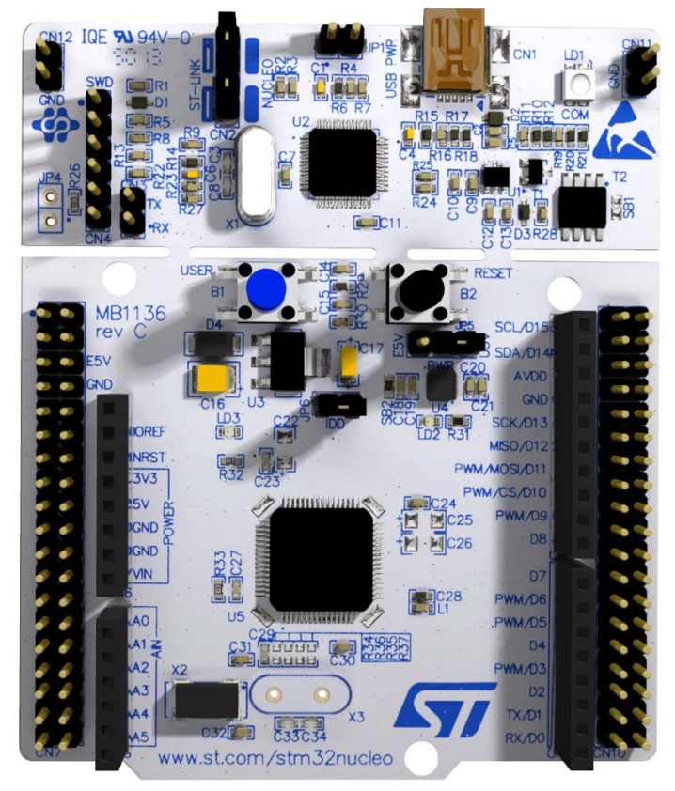
STM32 NUCLEO f401re
ST-LINK
(programmer)
STM32 NUCLEO BOARD

Slide 9
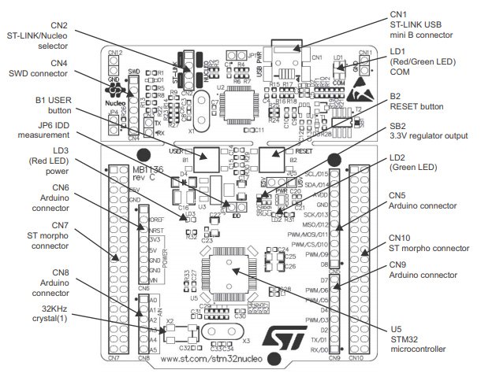
STM32 NUCLEO f401re

Slide 10
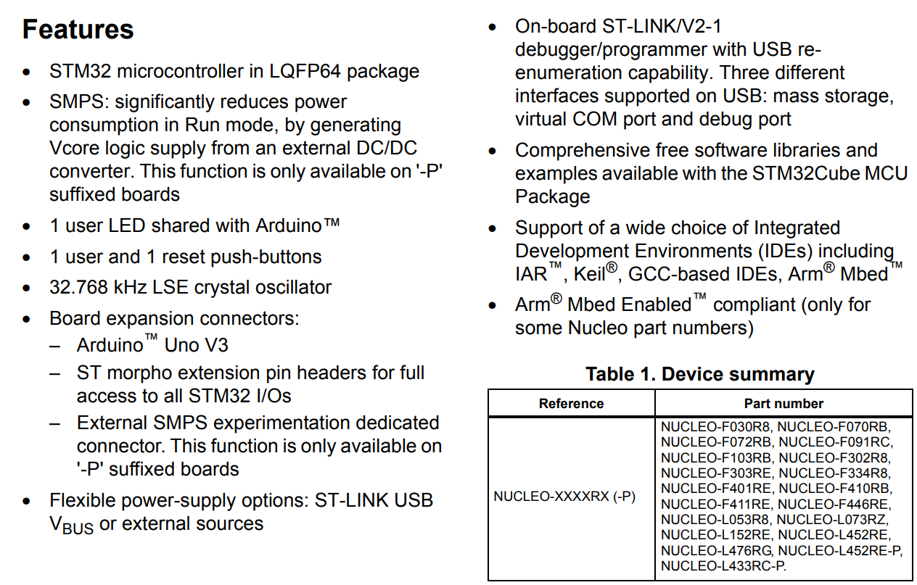
STM32 NUCLEO f401re

Slide 11
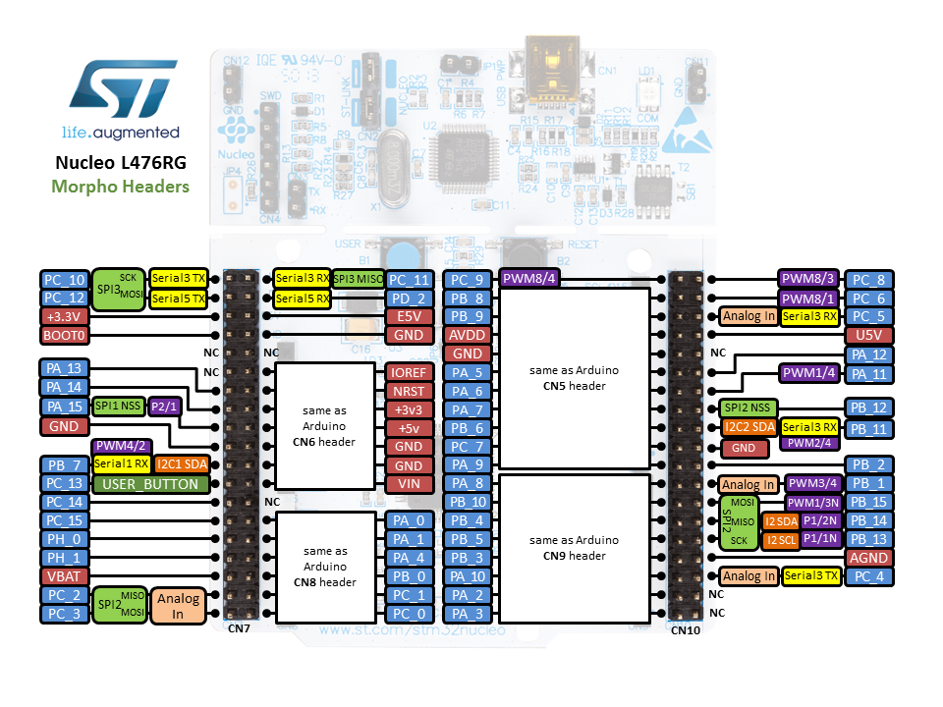
STM32 NUCLEO f401re

Slide 12
Stm32 cubemx

Slide 13
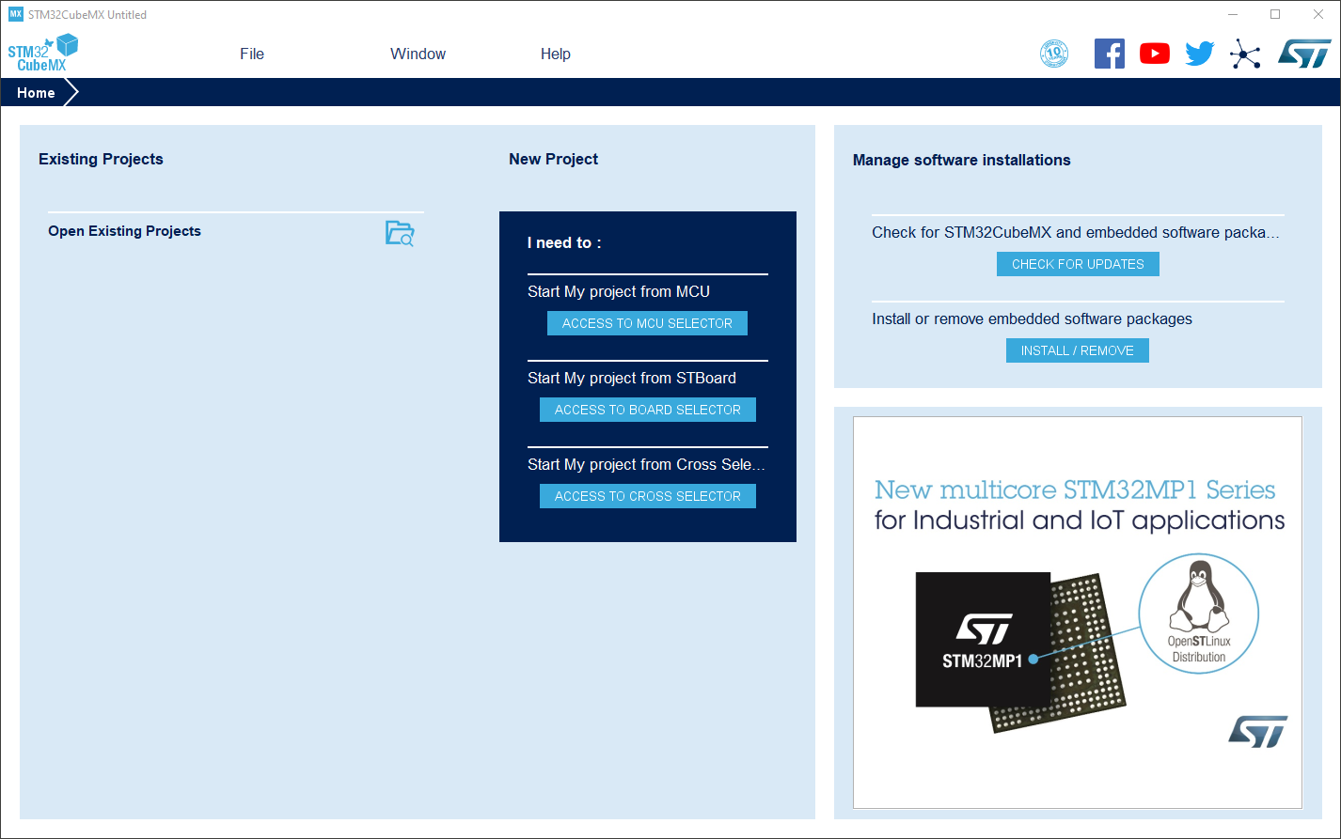
Stm32 cubemx – selecting the board
A graphical tool which enables fast configuration of STM32 microcontrollers and microprocessors.
Generates the corresponding C code for the Arm Coretex core.

Slide 14
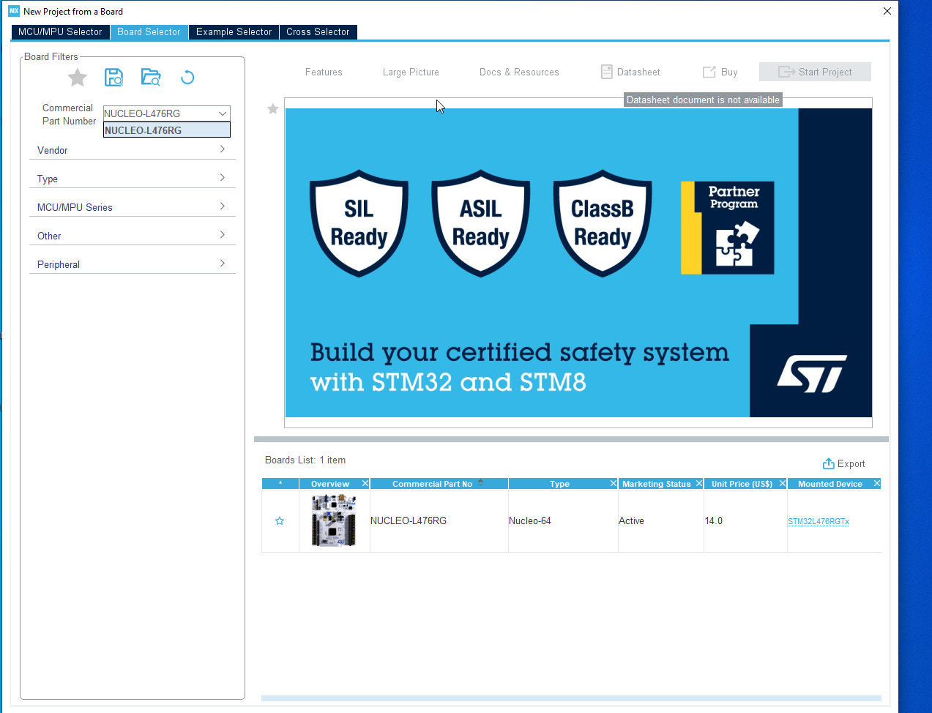
Stm32 cubemx – selecting the board

Slide 15
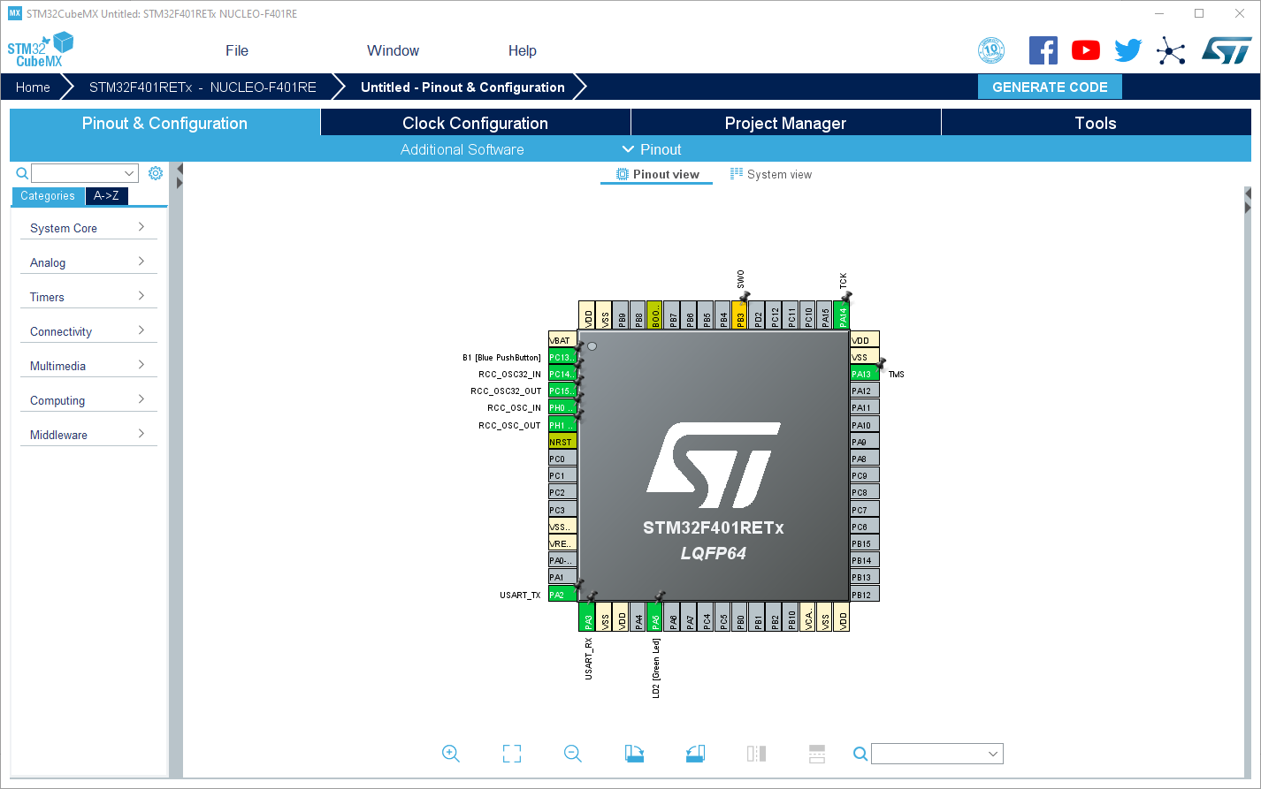
Stm32 cubemx – multiplexing the pins
Selected pins are preassigned, since we are using a development board, with predefined connections

Slide 16
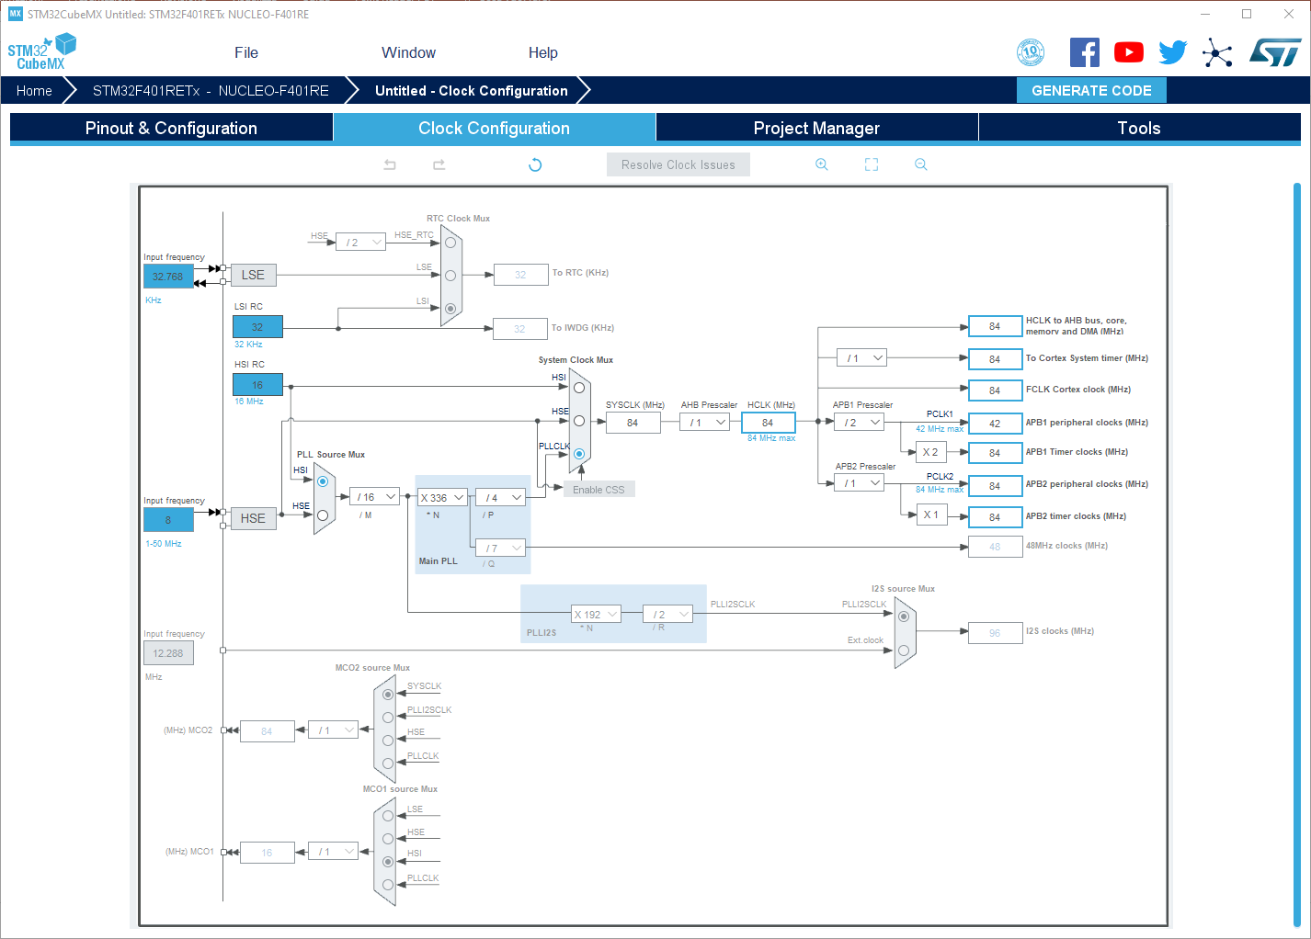
Stm32 cubemx – setting the clocks
PERIPHERAL CLOCK
CLOCK
SOURCE
CPU FREQ
Clock tab allows us to configure the clock. Here you can select your clock source, the CPU frequency and the peripheral clock

Slide 17
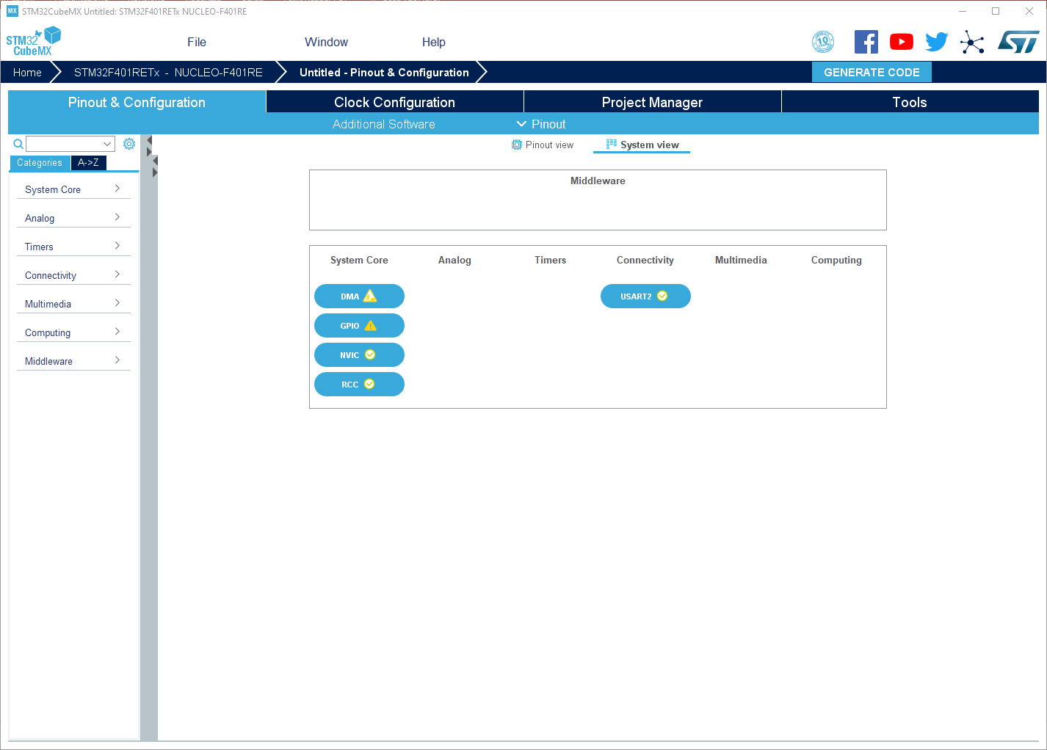
Stm32 cubemx – configuring the peripherals
System view tab allows us to configure all the peripheral. As you activate the peripheral from “Pinout” tab, those will be added here

Slide 18
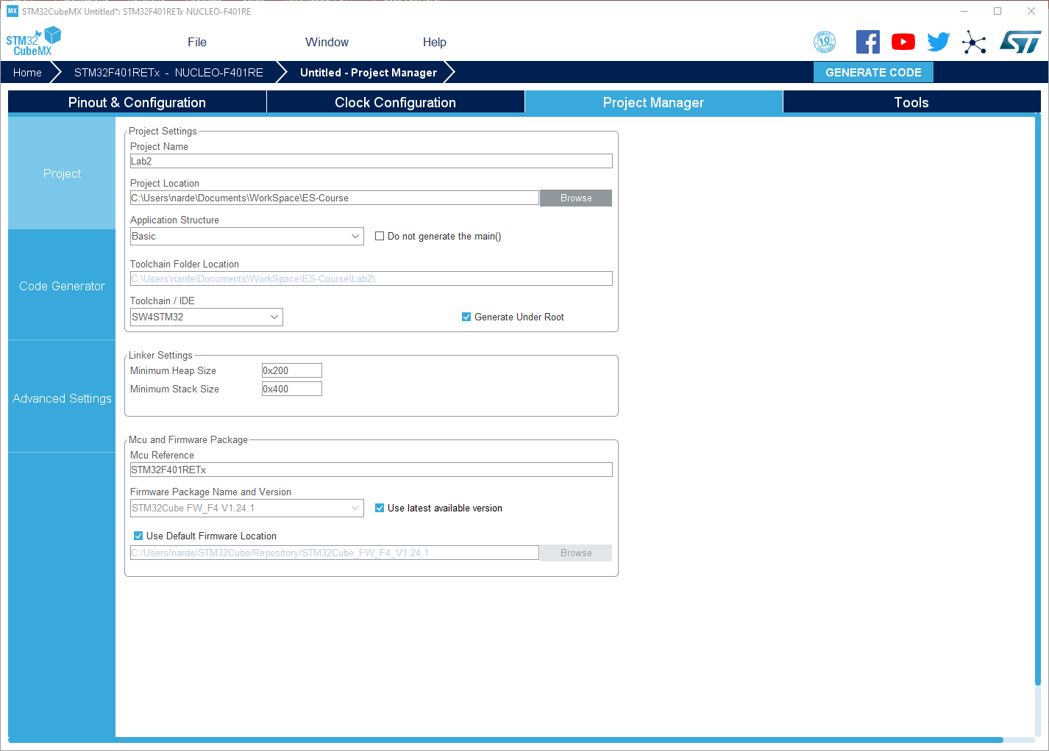
Stm32 cubemx – setting the toolchain
Change the toolchain / IDE to system workbench
Once everything is configure, we can generate the code

Slide 19
Systemworkbench
for stm32

Slide 20
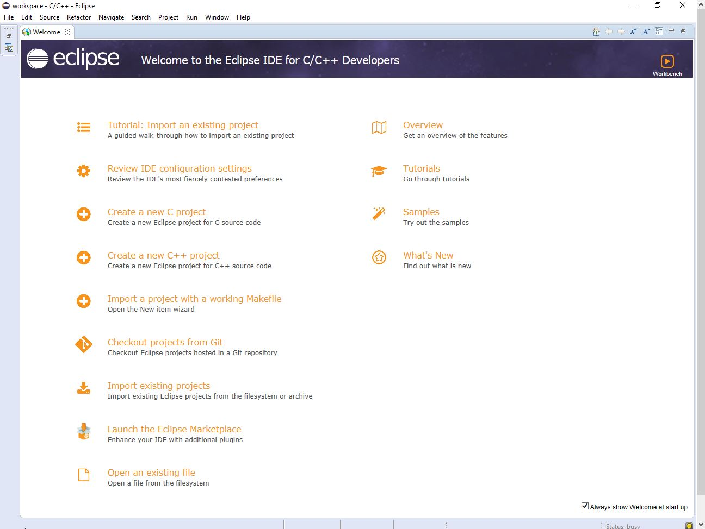
Stm32 – system workbench

Slide 21
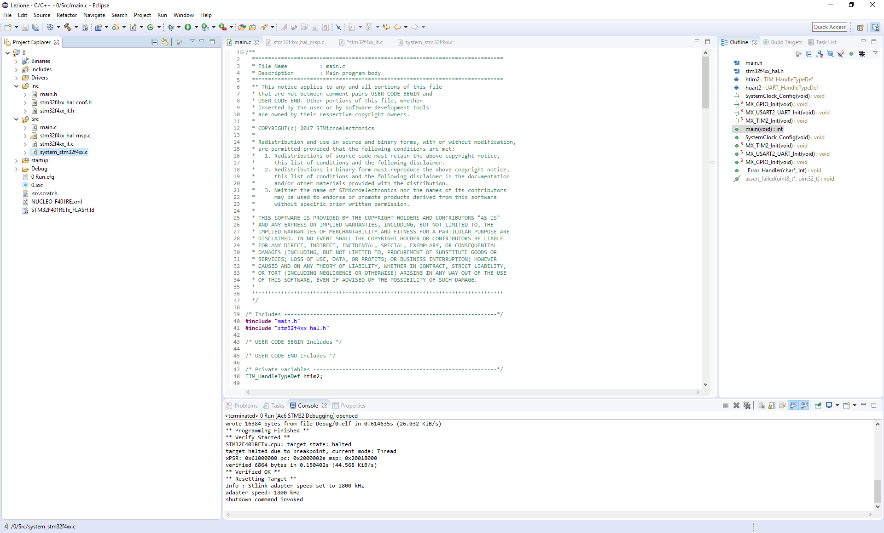
Stm32 – system workbench
main.c -> Main file
stm32f4xx_it.c -> Interrupt service routine
stm32f4xx_hal_msp.c -> HAL library initialization
system_stm32f4xx.c -> System low level config

Slide 22
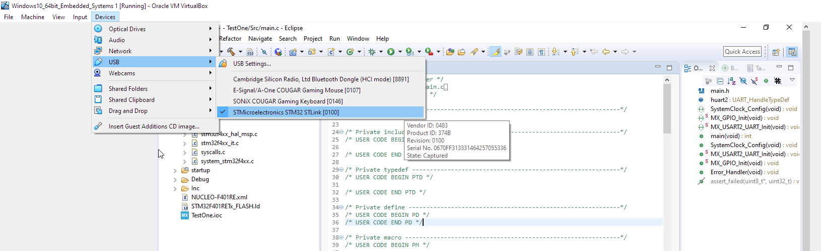
Stm32 – system workbench
If you are using a virtual machine, before building and compiling, be sure to have enabled the STM board as a USB Device

Slide 23
Stm32 – system workbench
We can build the code pressing the hammer icon, while for executing it inside our development platform, press the green arrow

Slide 24
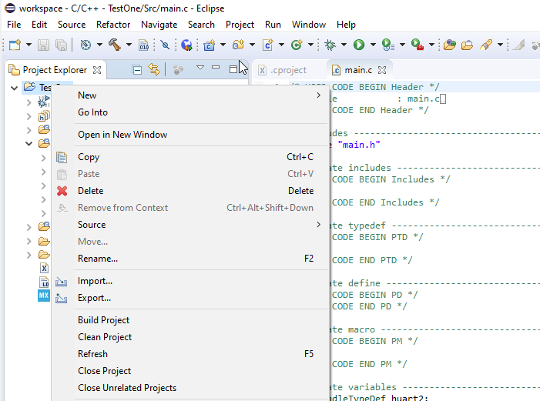
Stm32 – system workbench
If you do not have any available options on the “Run as” menu, right click on your project folder and try a “Refresh”.
If the issue still appears, try with “Clean Project”, rebuild it and refresh it.

Slide 25
Additional material
MCU Datasheet
http://www.st.com/content/ccc/resource/technical/document/datasheet/30/91/86/2d/db/94/4a/d6/DM00102166.pdf/files/DM00102166.pdf/jcr:content/translations/en.DM00102166.pdf
STM32 Nucleo-64 User manual
http://www.st.com/content/ccc/resource/technical/document/user_manual/98/2e/fa/4b/e0/82/43/b7/DM00105823.pdf/files/DM00105823.pdf/jcr:content/translations/en.DM00105823.pdf

